Slide 1
3D virtual touring site
-Om Ghag (19302D00004)&
Tabish Karadkar(19302C0019)

Slide 2
Problem Statement
Covid-19 :
The world is facing a global health, social and economic emergency with the pandemic because of which people are unable to leave their homes
Effect on tourism:
travel and tourism is among the most affected sectors with airplanes on the ground, hotels closed and travel restrictions put in place in virtually all countries around the world.

Slide 3
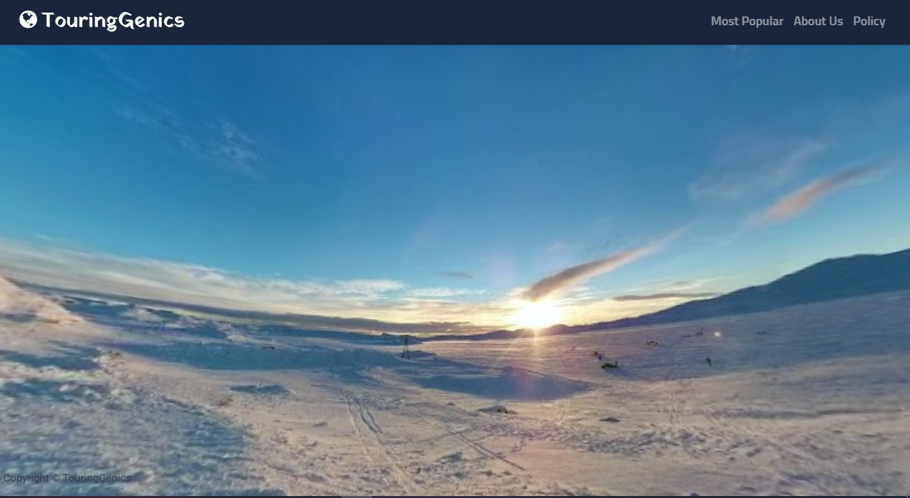
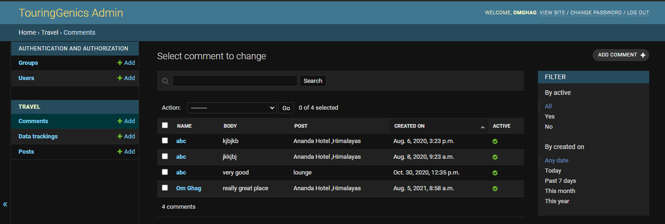
Project Working
3D images :
Admin page:

Slide 4
Module Wise Functionality
Three JS
Bootstrap
TinyMCE
NLPT(Natural Language processing Tools)
IP2Geo Tools

Slide 5
Software used
Frontend:
HTML
CSS
JAVASCRIPT
Backend:
Django (Python)
Sqlite3

Slide 6
Thank You

